Slide 1
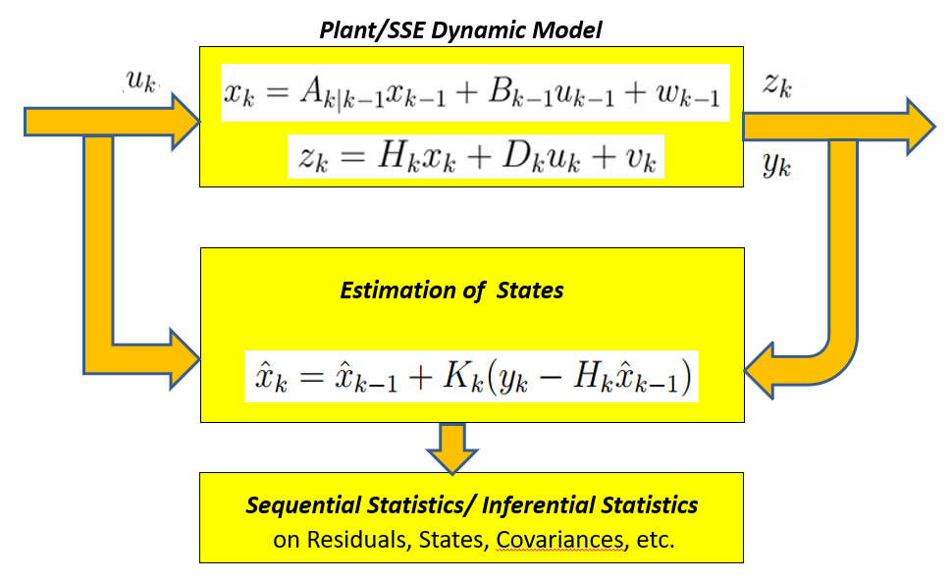
Review of Lecture 10-B : Why Estimate ?
Predictive Maintenance
Fault Detection & Diagnostics
Systems Faults
Actuator Faults
Sensor Faults
Monitoring Residues
Monitoring States
Monitoring Convergence of
Prior & Posterior Covariances
Multiple Model Methods
Generalized Likelihood Method

Slide 2
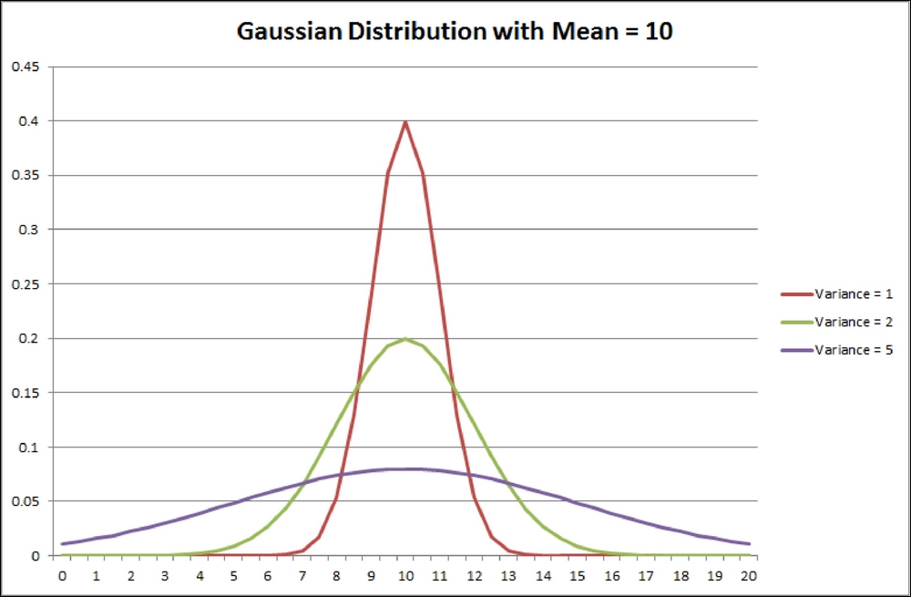
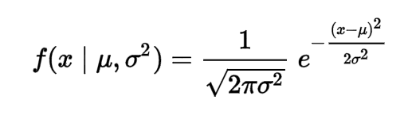
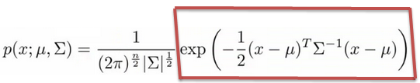
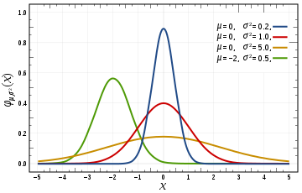
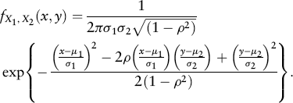
Building Uncertainty Models
Gaussian Distribution

Slide 3
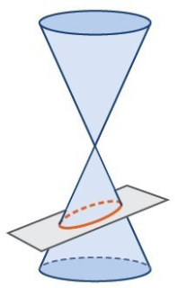
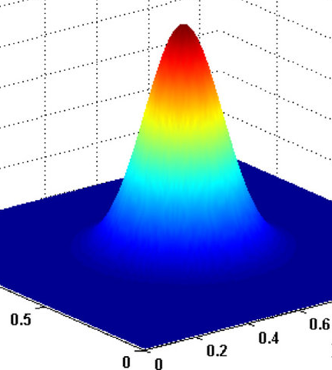
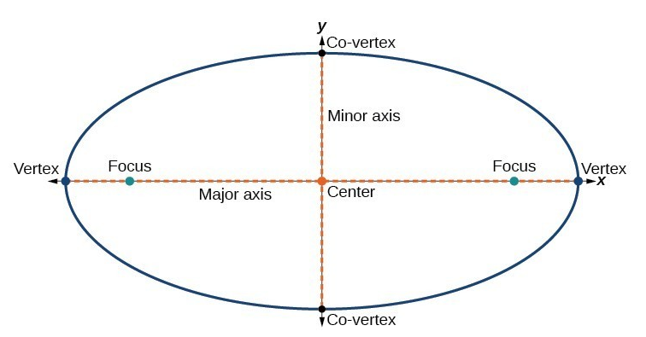
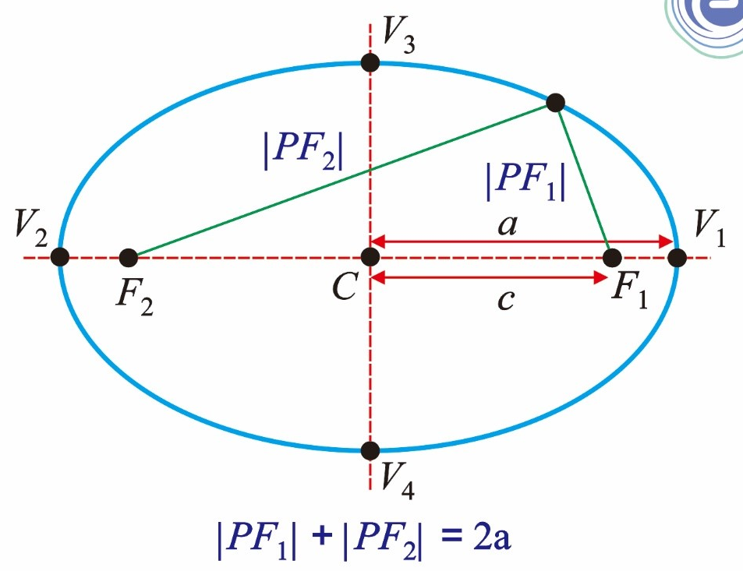
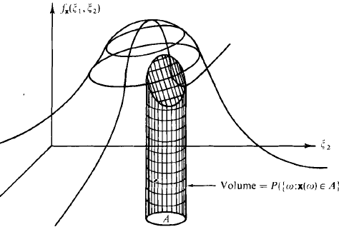
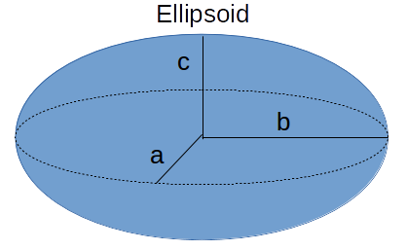
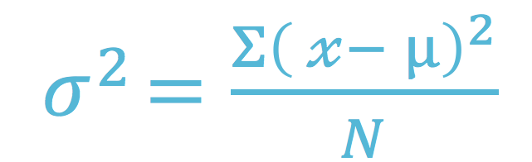
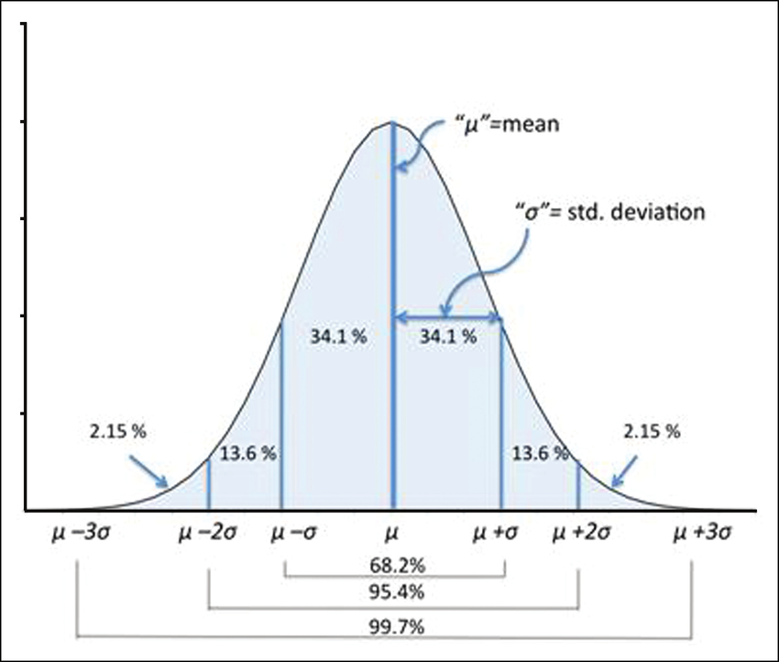
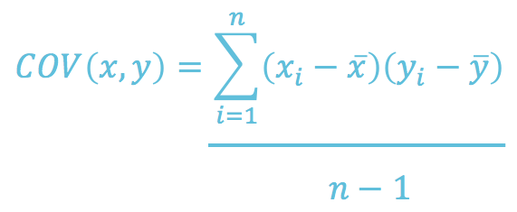
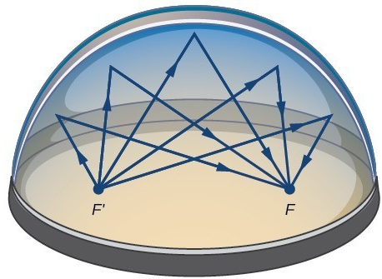
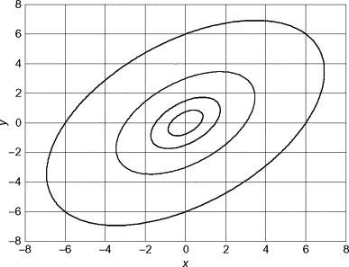
Ellipsoid as a Measure of Gaussian Uncertainty

Slide 4
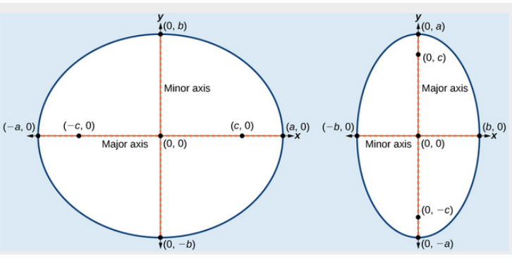
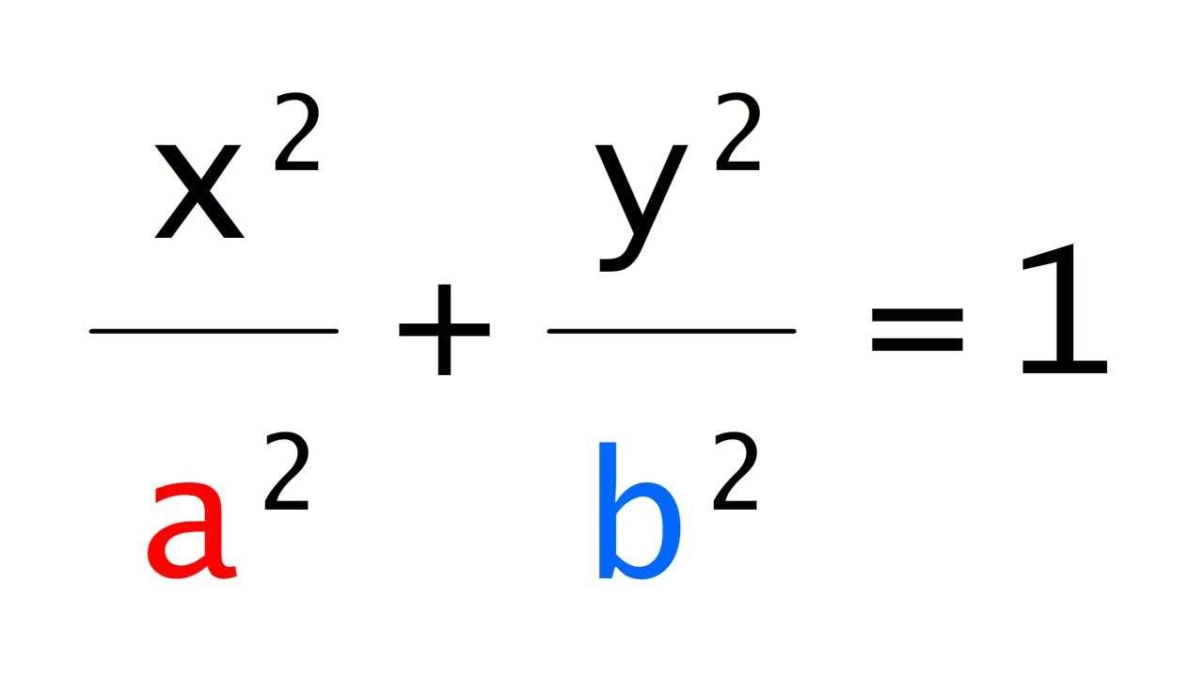
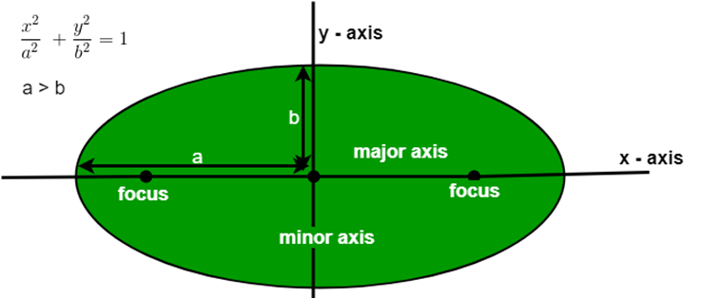
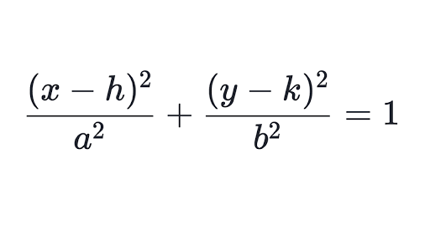
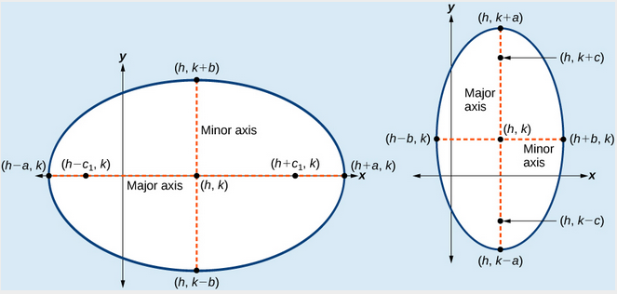
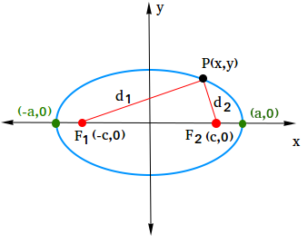
Further Insight of the Ellipse

Slide 5

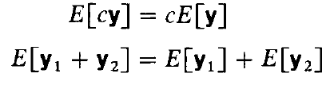
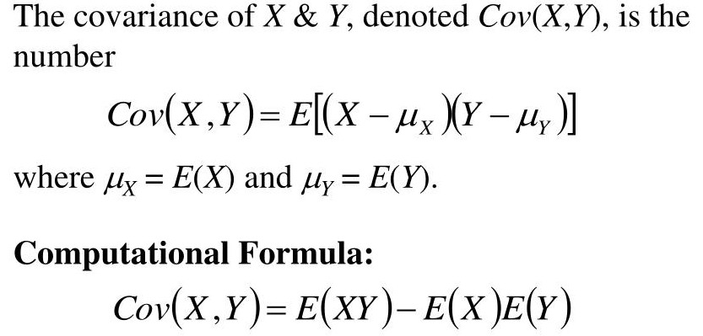
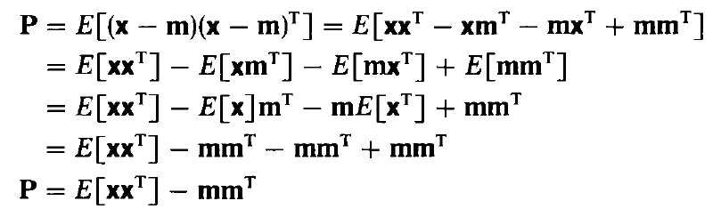

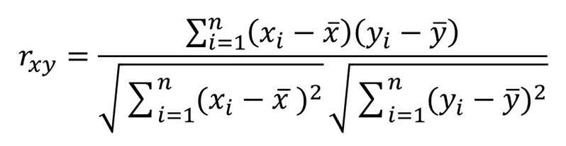
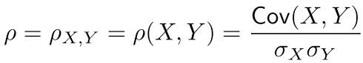
The Statistical Moments

Slide 6


Takeaways : Kalman Filter in the Bayesian Framework
Lecture-11-A
Update
(k-1)+
(k)-
(k)+
Prediction
k-1
k
z(k-1)
z(k)
Propagation of a Conditional Density Function

Slide 7
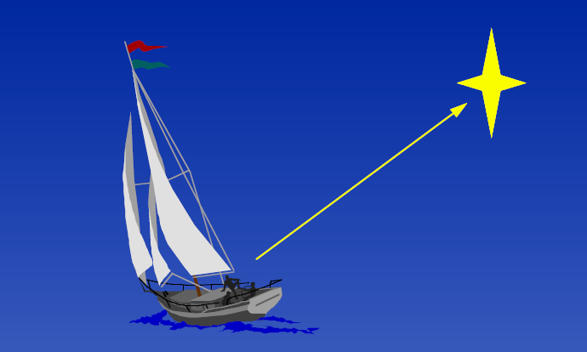
Navigating --- Propagating a Conditional PDF?
Say, you are lost in sea. However, you have some idea on obtaining directions from the pole-star
Obtain a measurement

Slide 8
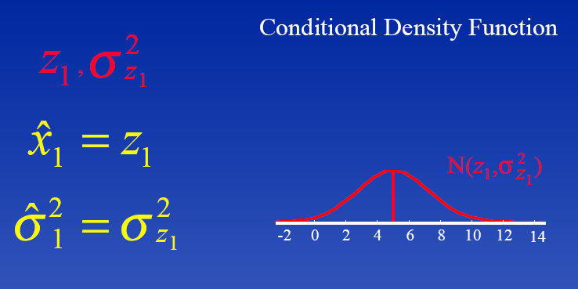
Asess the Measurement
The measurement may not be exact
It would have a mean and a variance

Slide 9
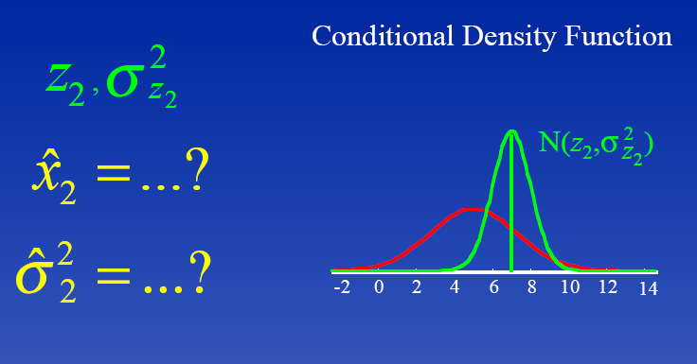
Update the Previous Measurement
Now, let’s say your friend is better in navigating
He takes a second measurement --- more accurate ?
Even this would have a mean and variance, but possibly
the variance would be smaller – he has more expertise

Slide 10
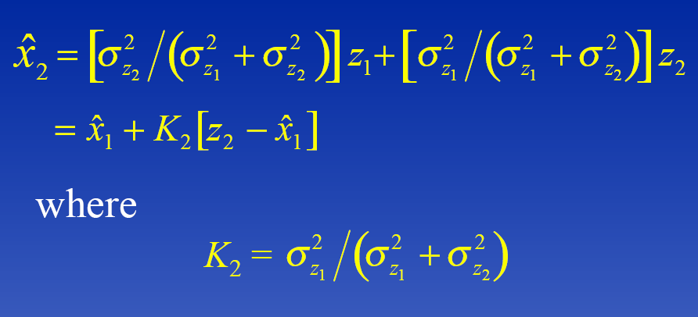
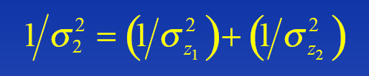
Assess the Results of Two Measurements
Now combining the variances, we obtain

Slide 11
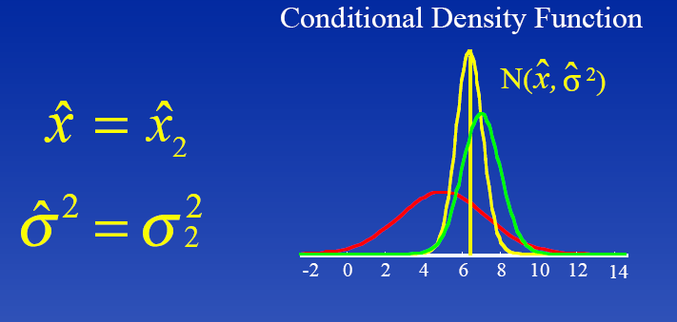
Result
The result is an improved idea as to how much away you are from the coast
Are we propagating a conditional density function and each time updating it with the latest measurement ?

Slide 12
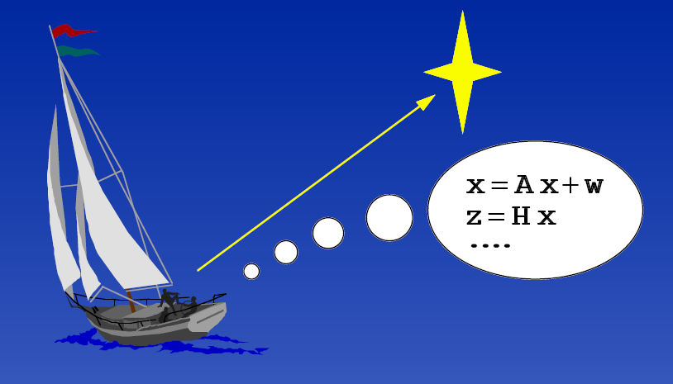
Adding Dynamics
Velocity of the Boat, dx/dt = v + w
Uncertainties (w)--- tide-drag, wind-speed, etc.

Slide 13
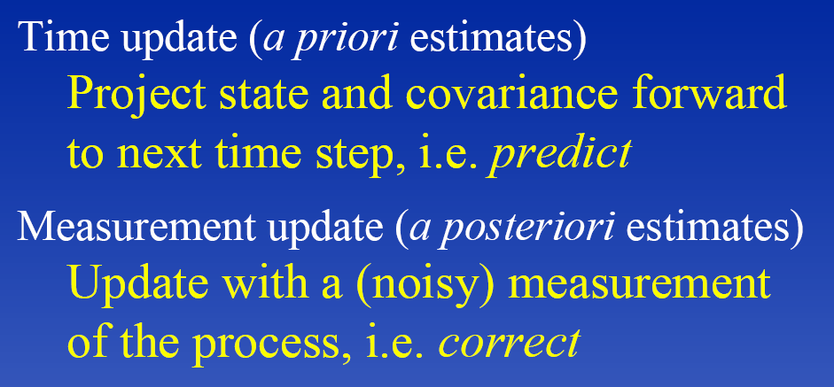
In effect the boat-people were doing thus

Slide 14
Thus

Slide 15
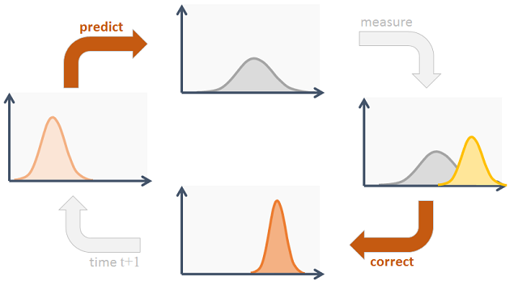
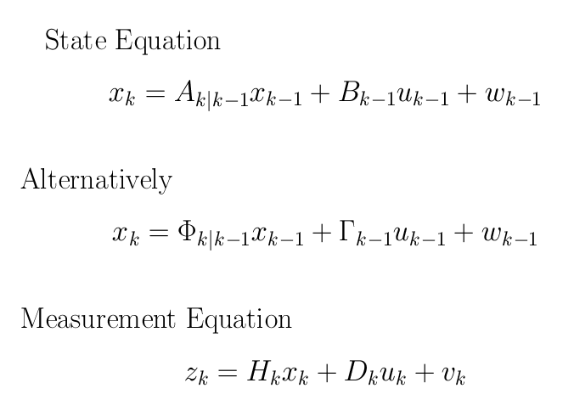
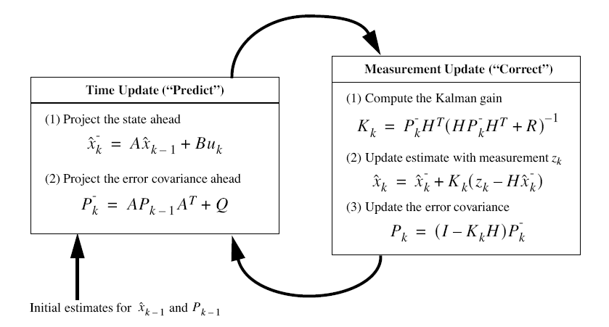
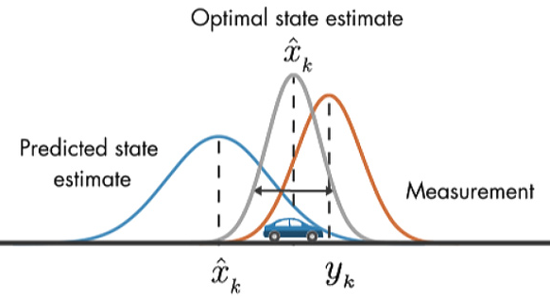
Kalman Filter – A Bayesian Approach

Slide 16


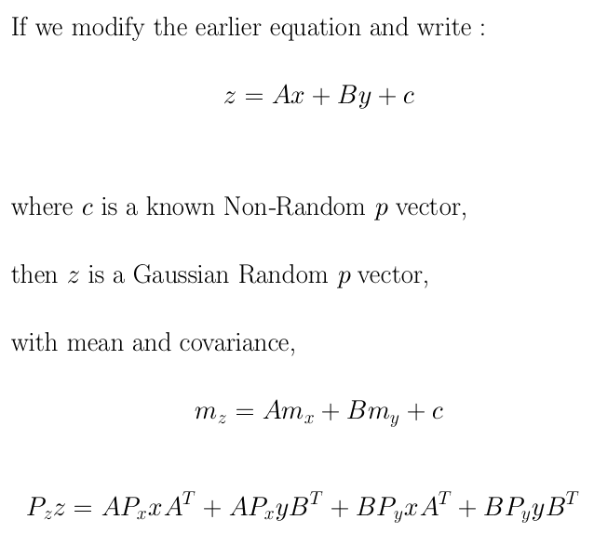



Review of the Prediction & Update Process/ Steps
Update
+ Q
(k-1)+
(k)-
(k)+
Prediction of the State
k
k-1
z(k)
z(k-1)

Slide 17







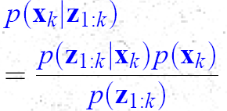
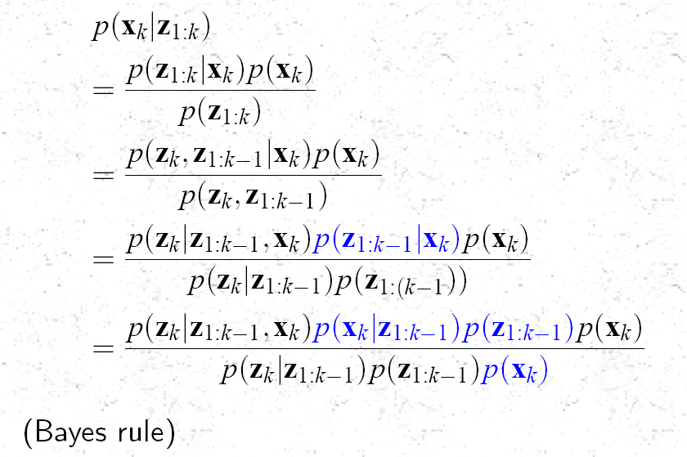
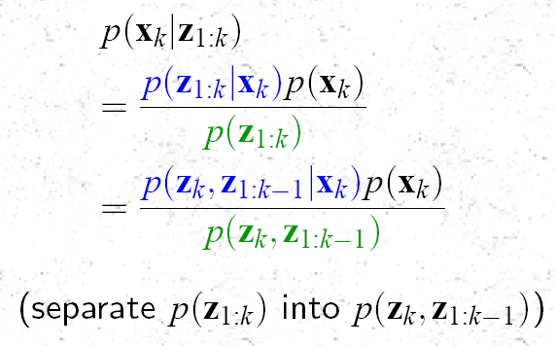

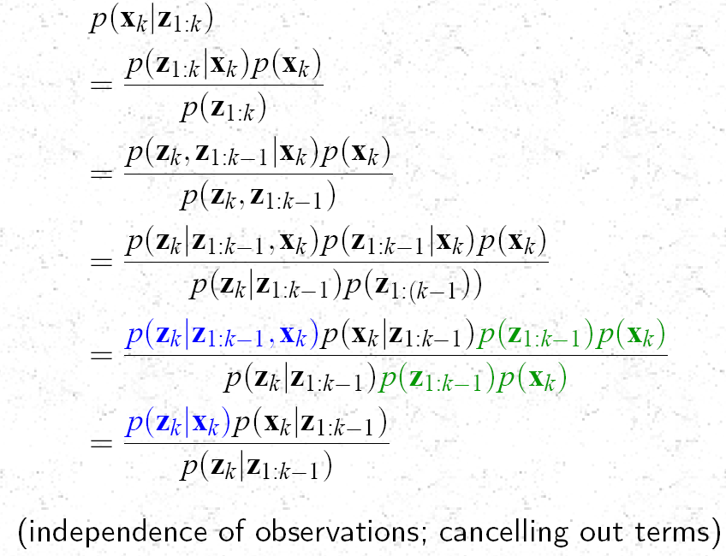
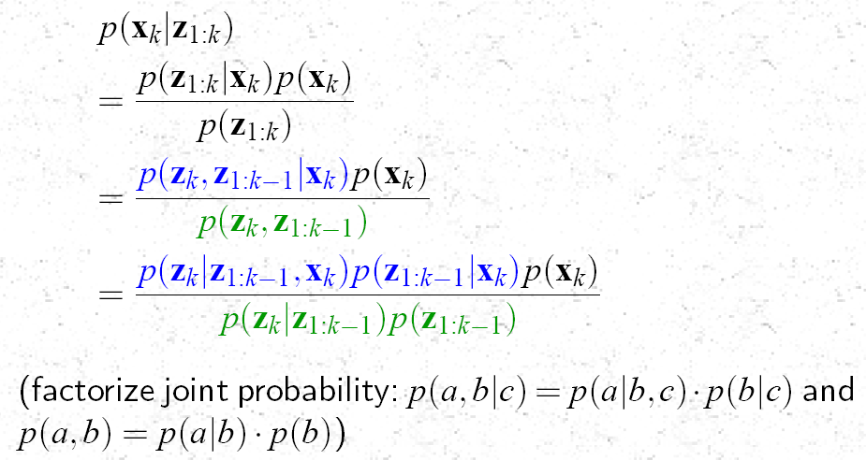
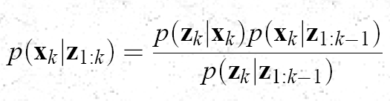
The “Posterior” Function
The Prior Function
Bayes’ Theorem
Update
Prediction
(k-1)+
(k)-
(k)+
k-1
k
z(k-1)
z(k)
To Show that Each
Term is
Gaussian

Slide 18
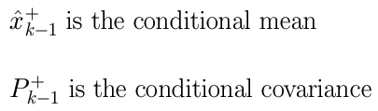

Formulating the Gaussian Density Function
Kalman Filter --- The Bayesian Approach
Establish the Independence of Noise Function
Establish Gaussianity of the Prior Function
Computing the Mean & Covariance of the Prior
Update
(k-1)+
(k)-
(k)+
Prediction
Mean & Covariance of the Likelihood
k-1
k
Show all three functions are Gaussian
z(k-1)
Likelihood Function
Prior Function
z(k)
Plug the Gaussian Expressions with Mean & Variance of each Term
Understand the “Posterior” Function
Evidence Function
Mean & Covariance of the Evidence

Slide 19
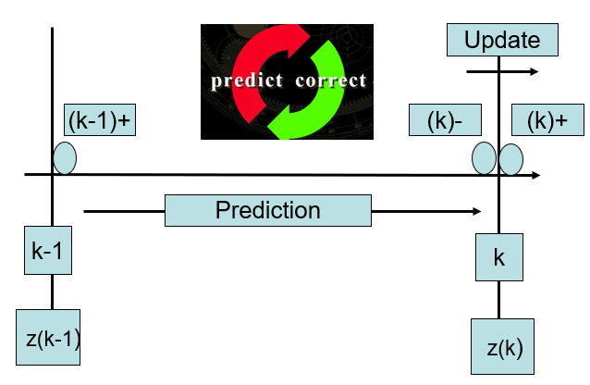
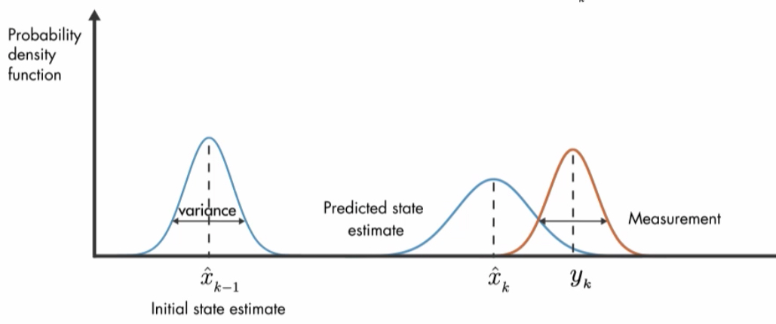
Plug the Gaussian Expressions with
Mean & Variance of each Term
Substituting expressions for PDF on the RHS
Likelihood
Prior
Evidence
By plugging in the Gaussian Expressions
of the Prior, Likelihood & Evidence Terms,
on the RHS, we Obtain
PDF for Posterior

Slide 20




Slide 21





Applications

Slide 22



Estimation and Performance Monitoring Strategies
Model Based Strategies
First Principle/ Domain/Physics based
Data Oriented
Feature Vectors
Statistical Approaches

Slide 23
Step-by-Step Derivation of the Bayesian Posterior
Update
(k-1)+
Prediction
(k)-
(k)+
k-1
k
z(k-1)
To Show that Each
Term is
Gaussian
z(k)

